Slide 1


Unit 3: Lesson 14
A wonderful world

Slide 2
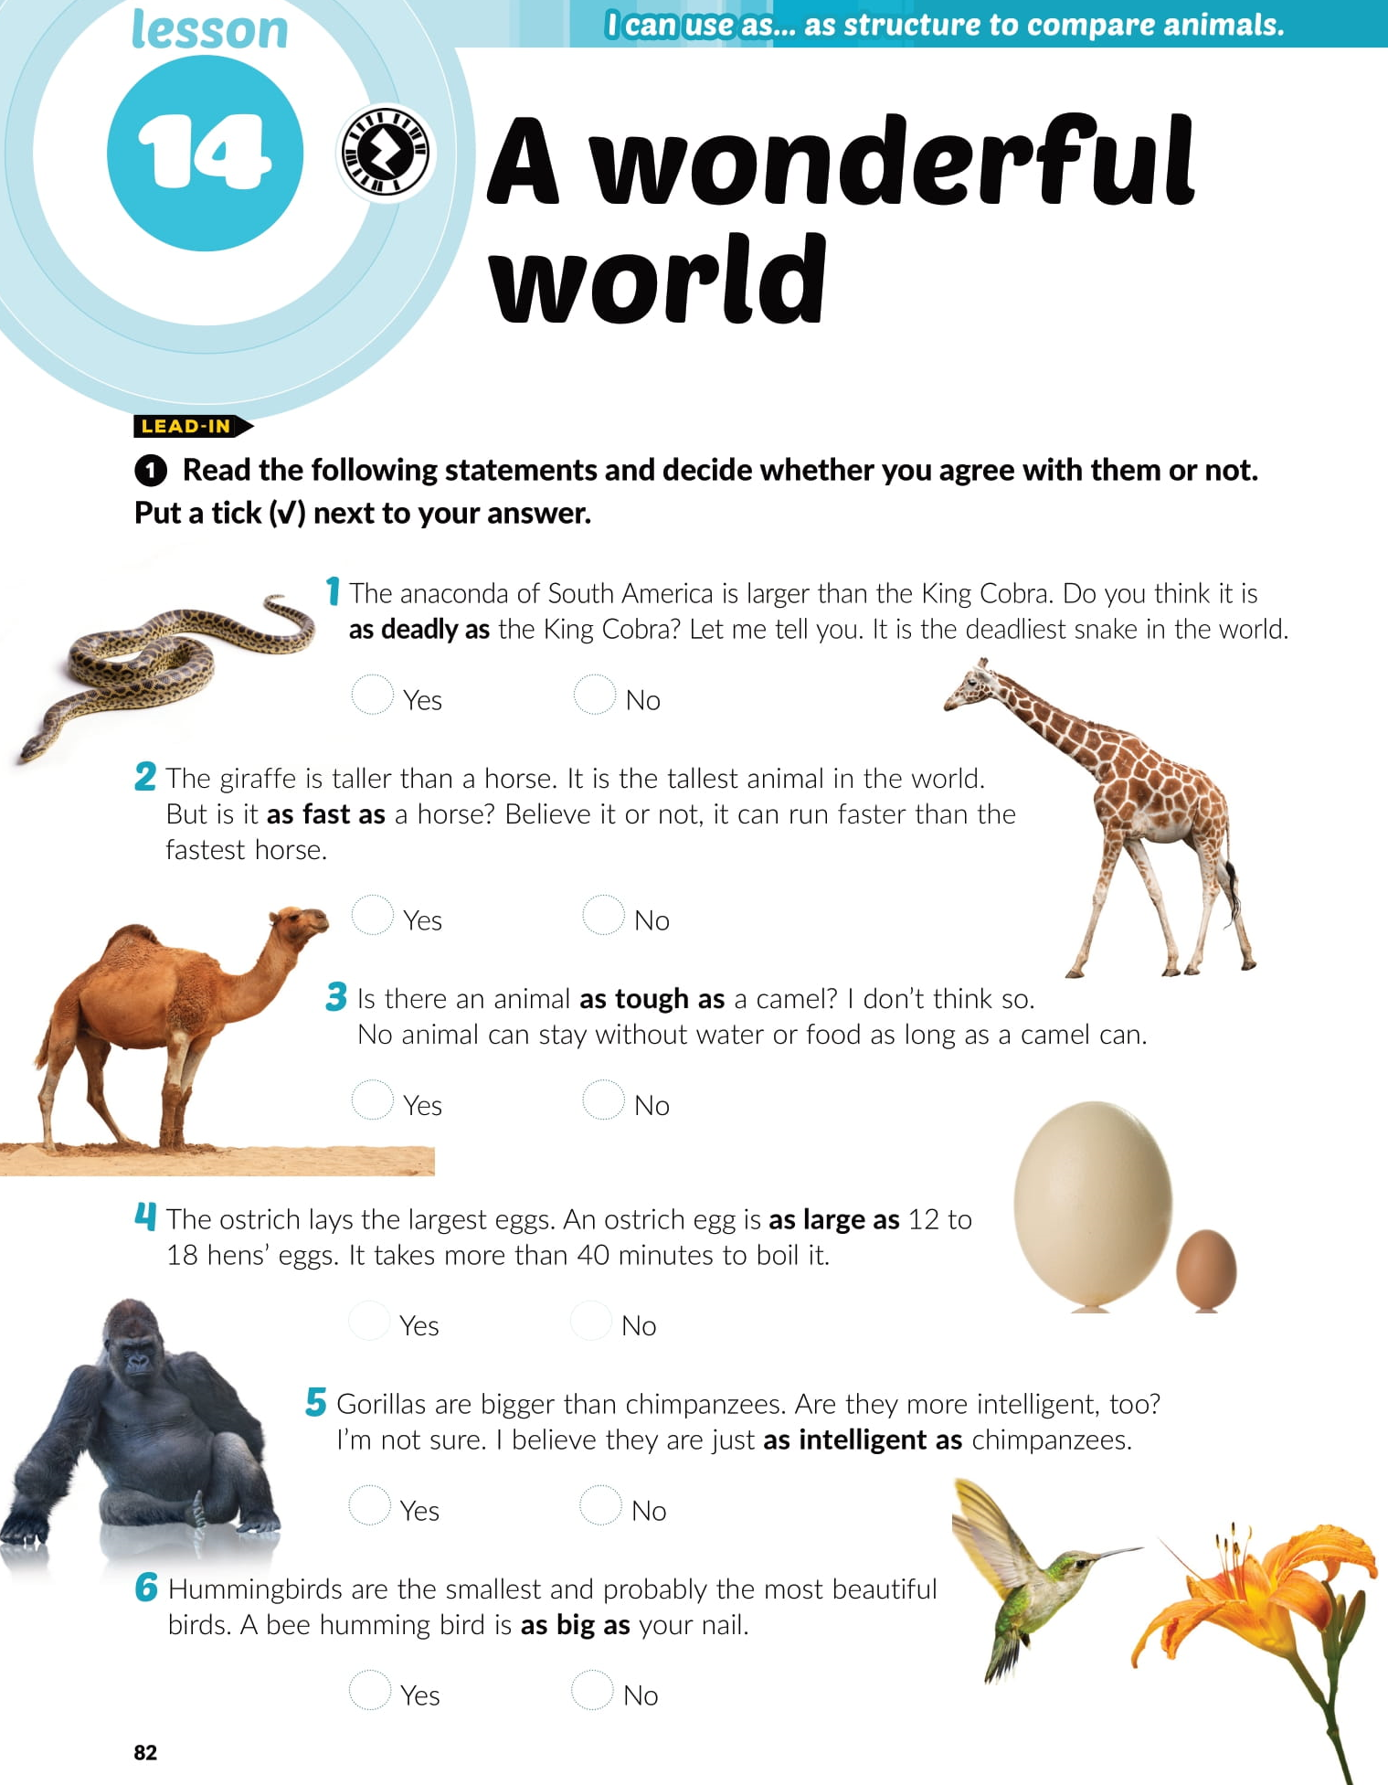
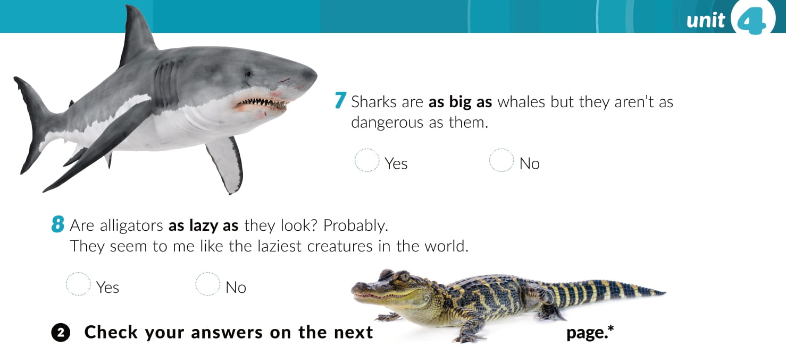

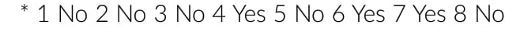

Slide 3
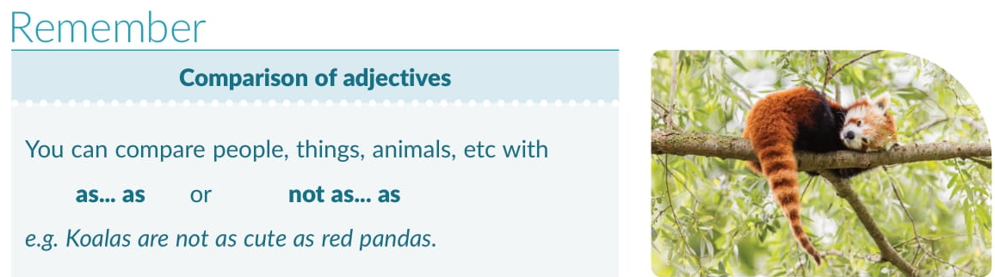
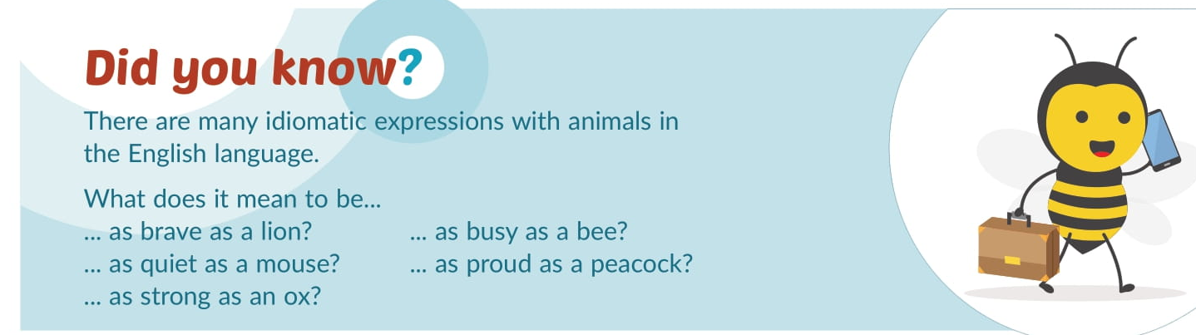

Slide 4
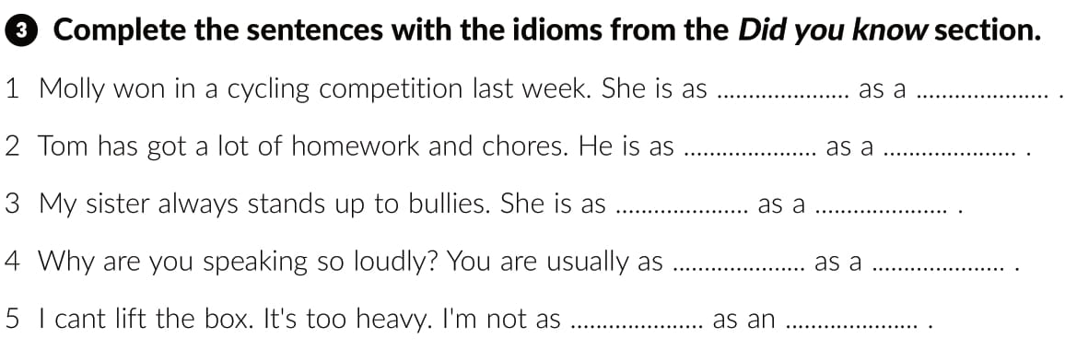
proud
peacock
busy
bee
brave
lion
quiet
mouse
strong
ox

Slide 5


Slide 6
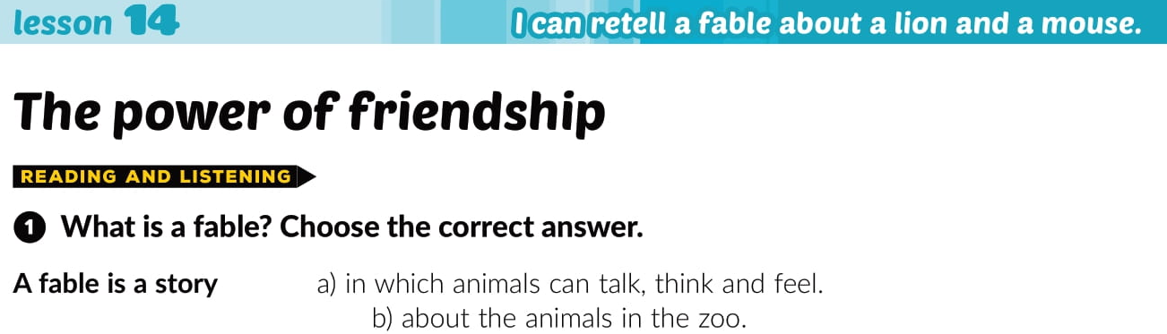
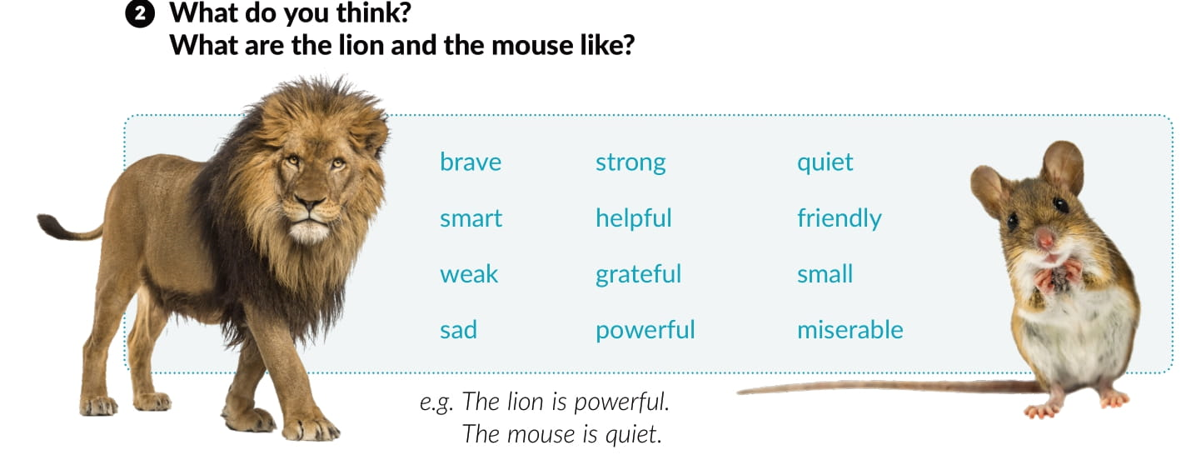

Slide 7
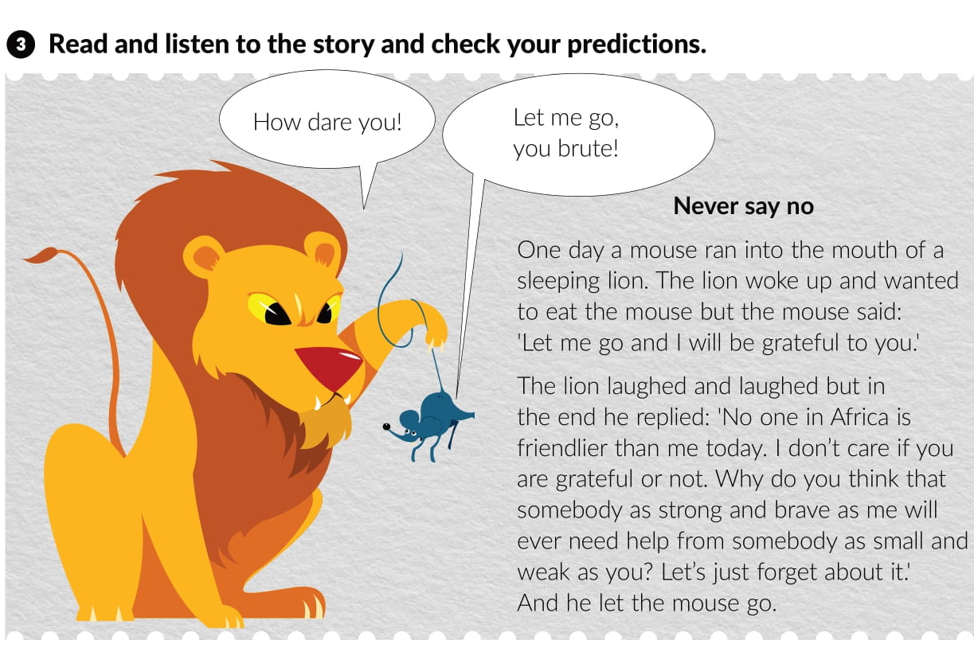

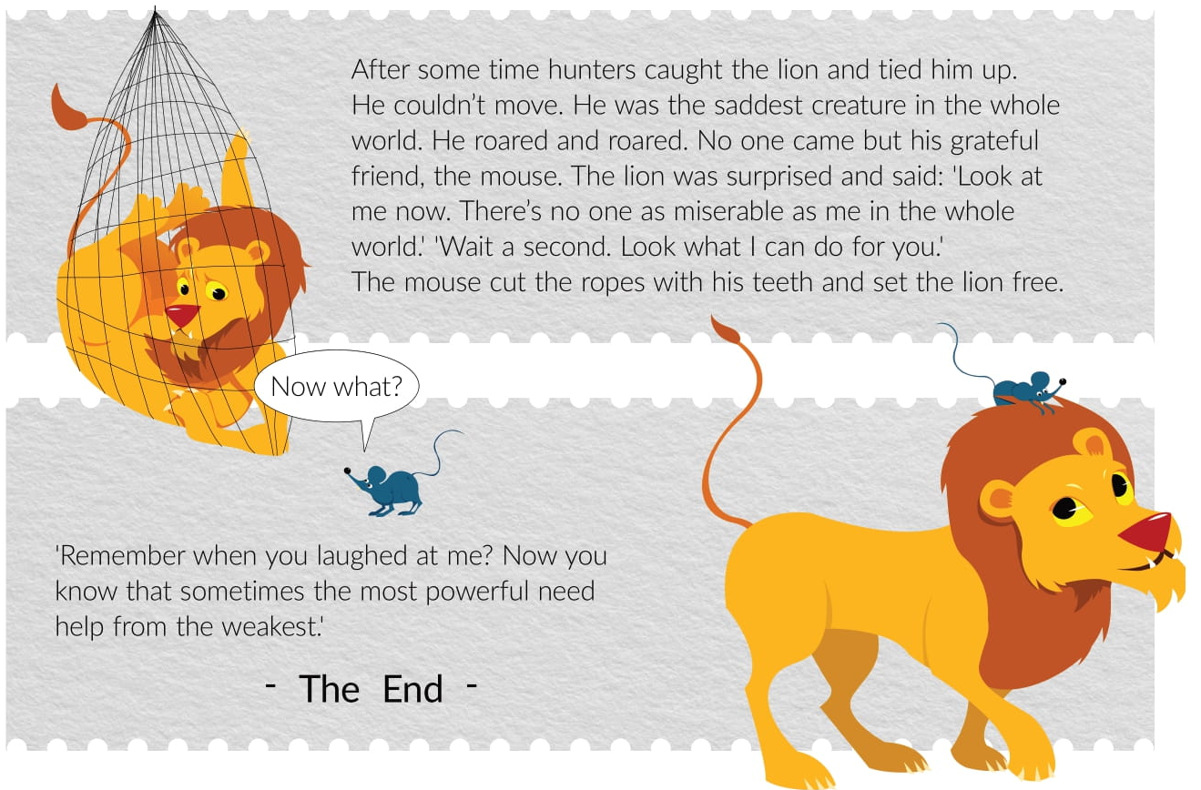

Slide 8
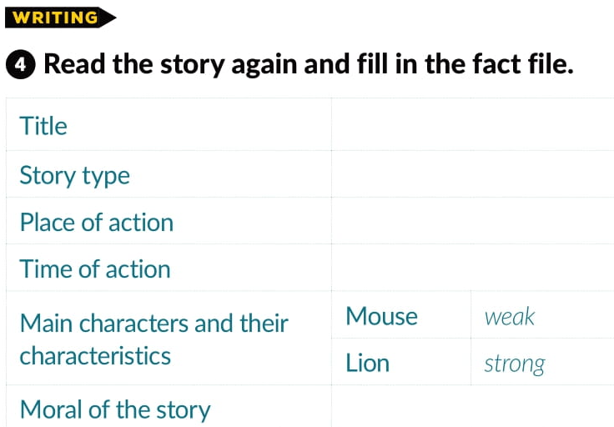
Never say no
fable
Africa
past
The powerful sometimes need help from the weak.

Slide 9
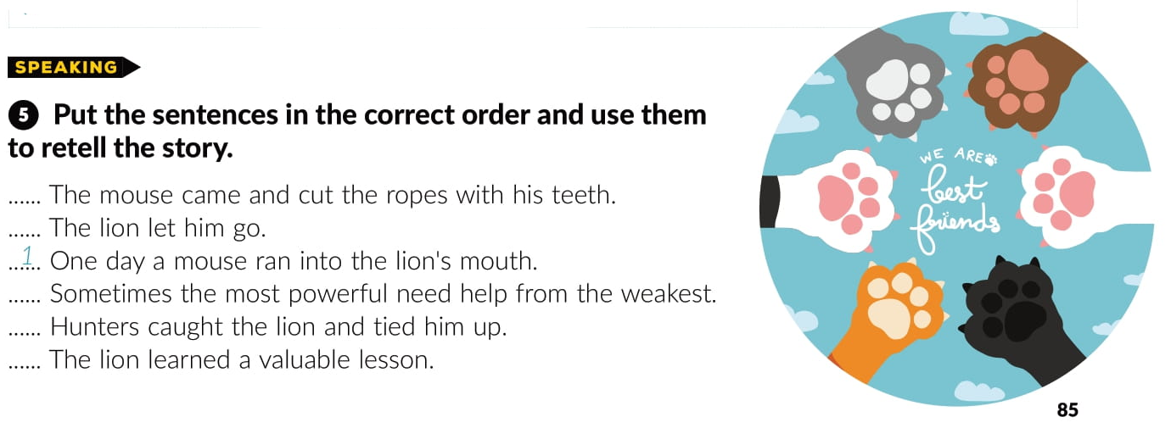
4
2
6
3
5

Slide 10
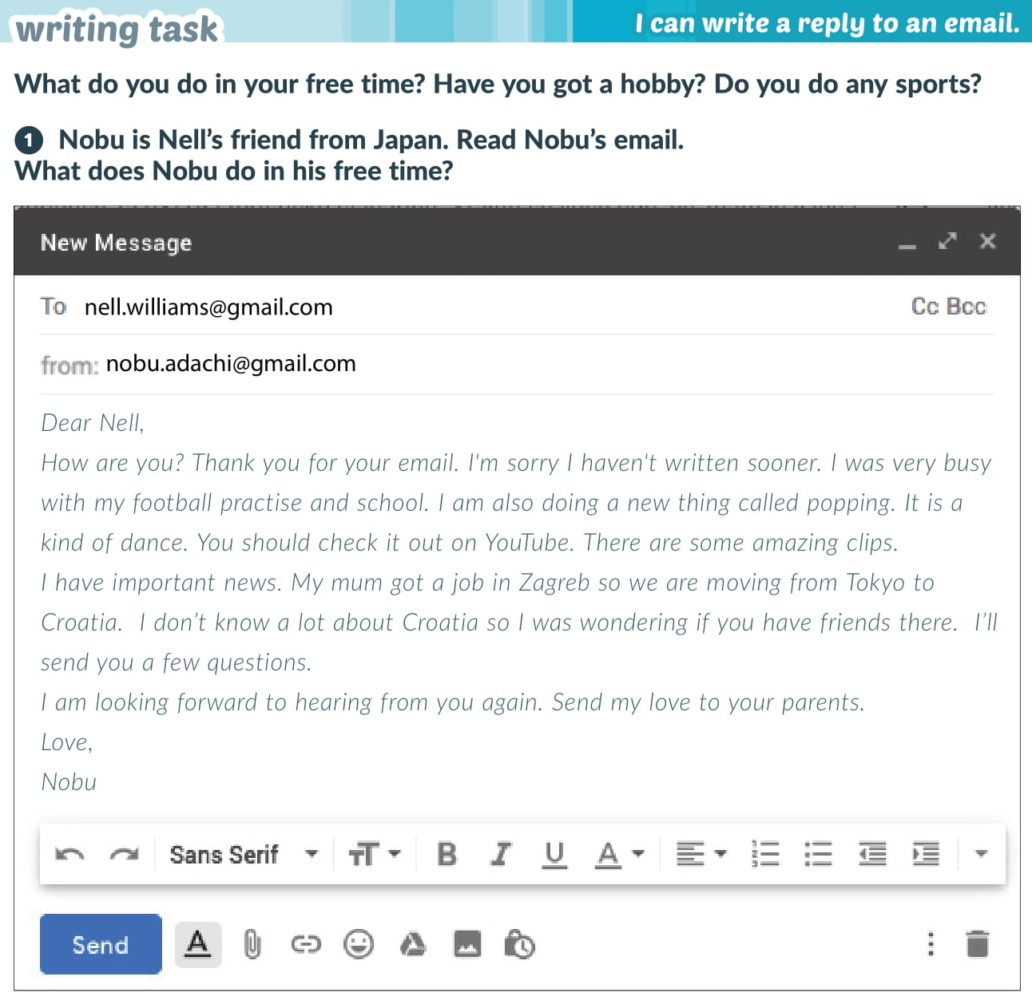

Slide 11
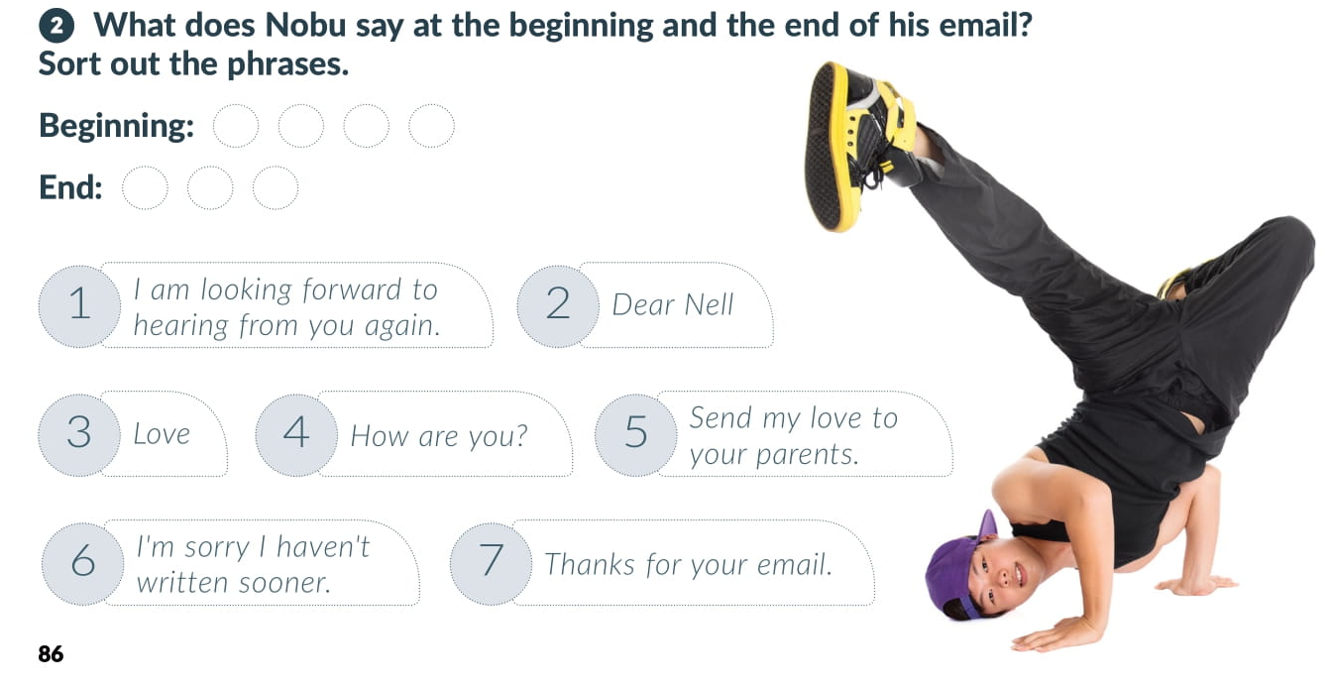
2
4
7
6
1
5
3

Slide 12
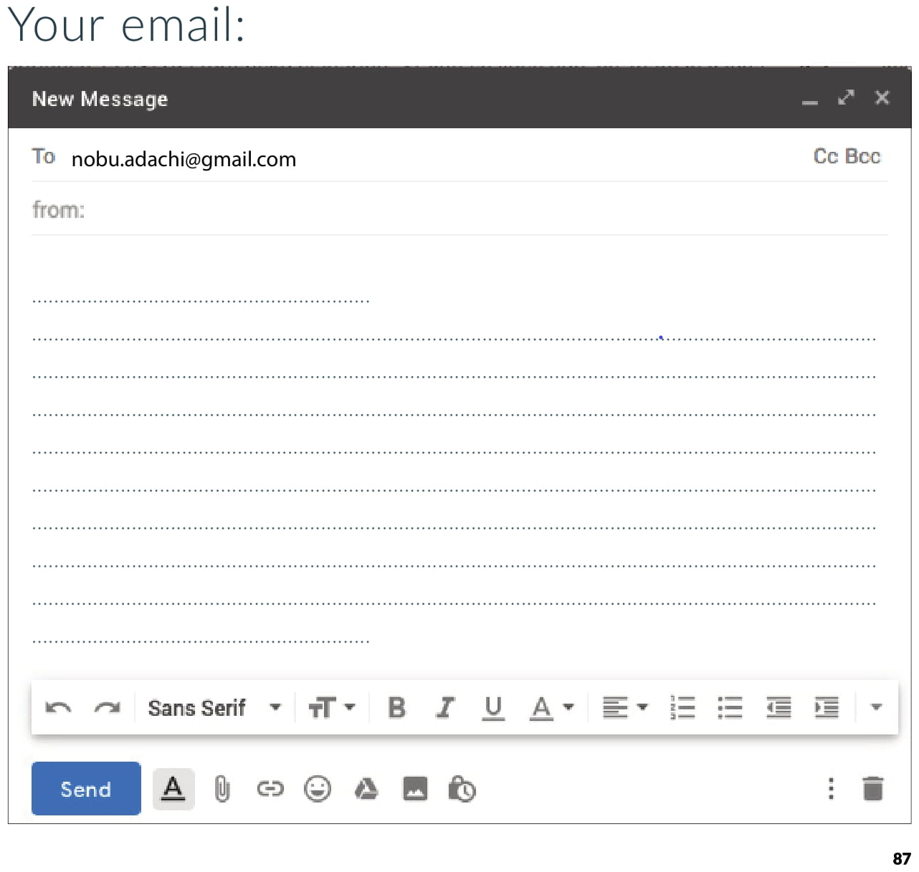
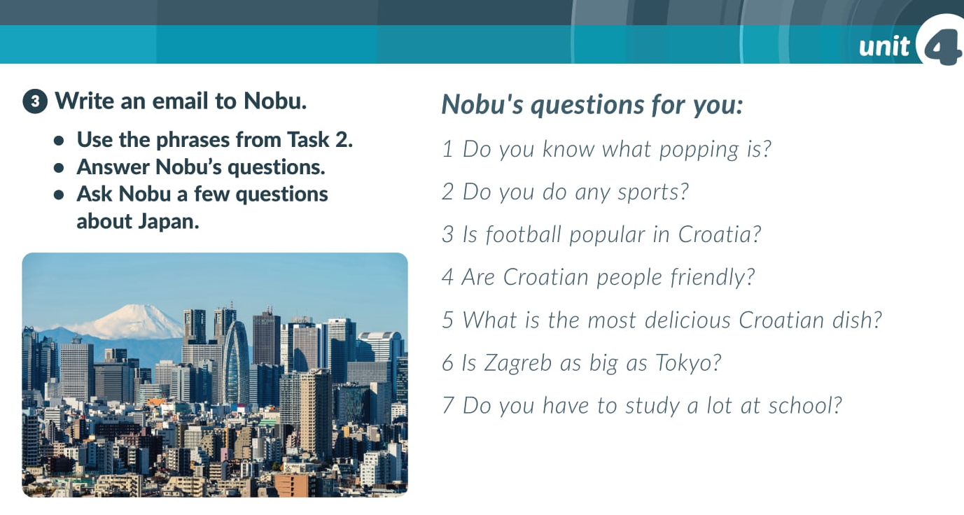

Slide 13
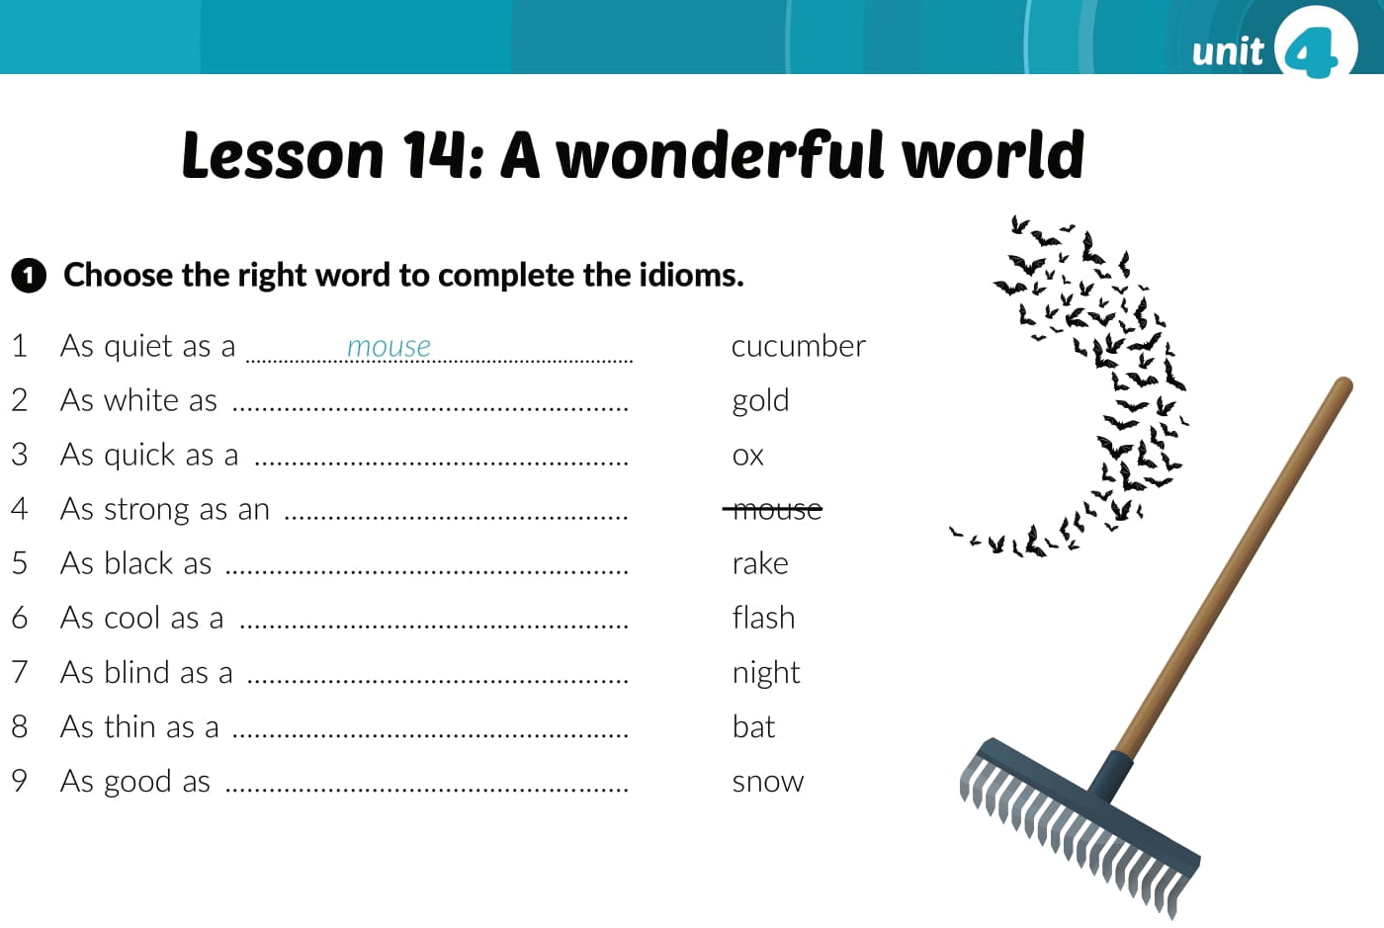
Workbook, p. 65
snow
flash
ox
night
cucumber
bat
rake
gold

Slide 14
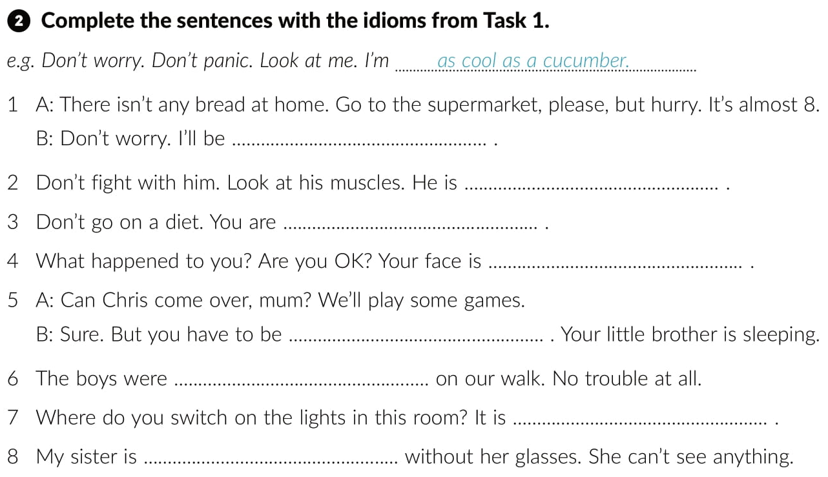
as quick as a flash
as strong as an ox
as thin as a rake
as white as show
as quiet as a mouse
as good as gold
as black as night
as blind as a bat

Slide 15
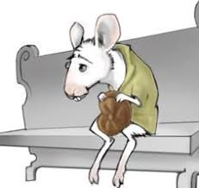
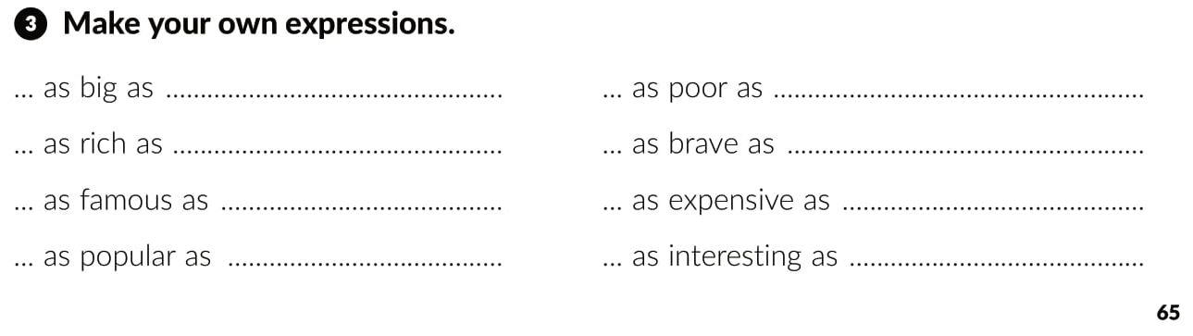

Slide 16
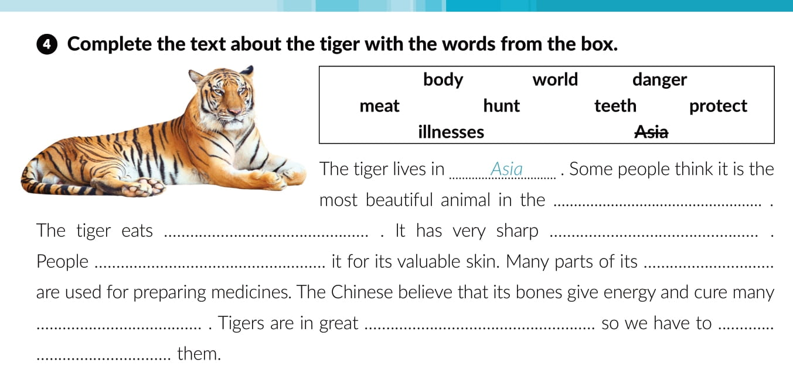
world
meat
teeth
hunt
body
illnesses
danger
protect

Slide 17
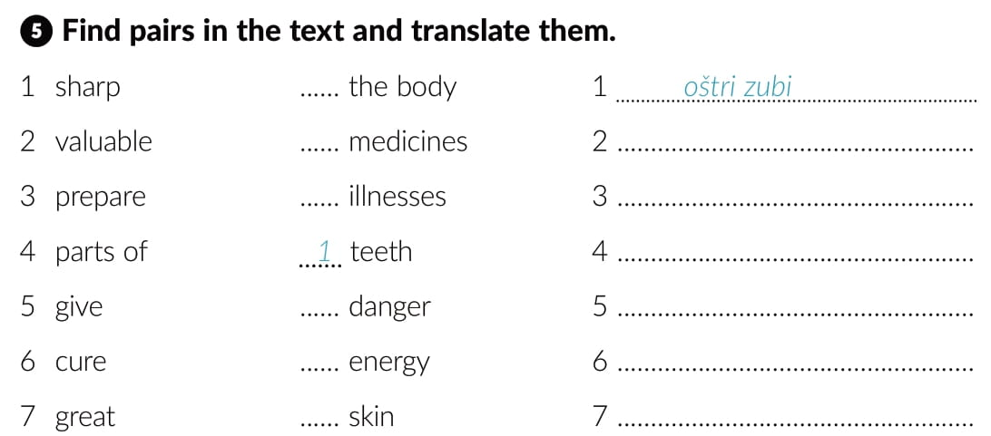
4
3
skupa koža
6
izrađivati lijekove
dijelovi tijela
7
davati energiju
5
liječiti bolesti
2
velika opasnost

Slide 18
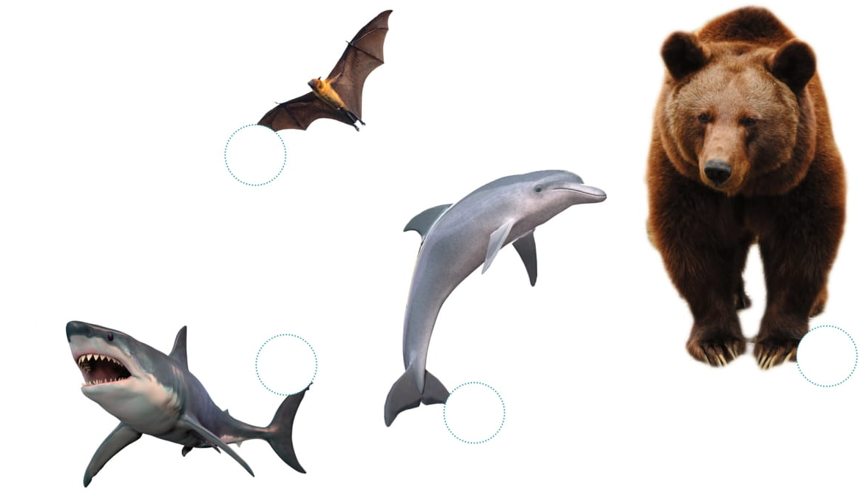
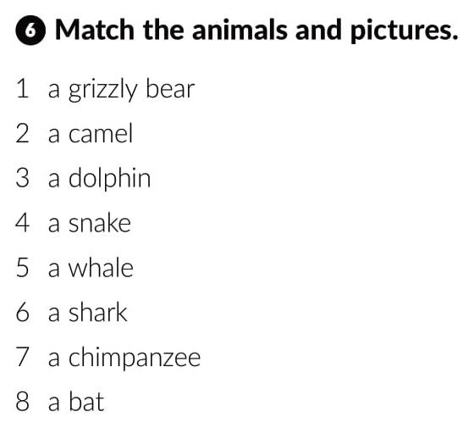
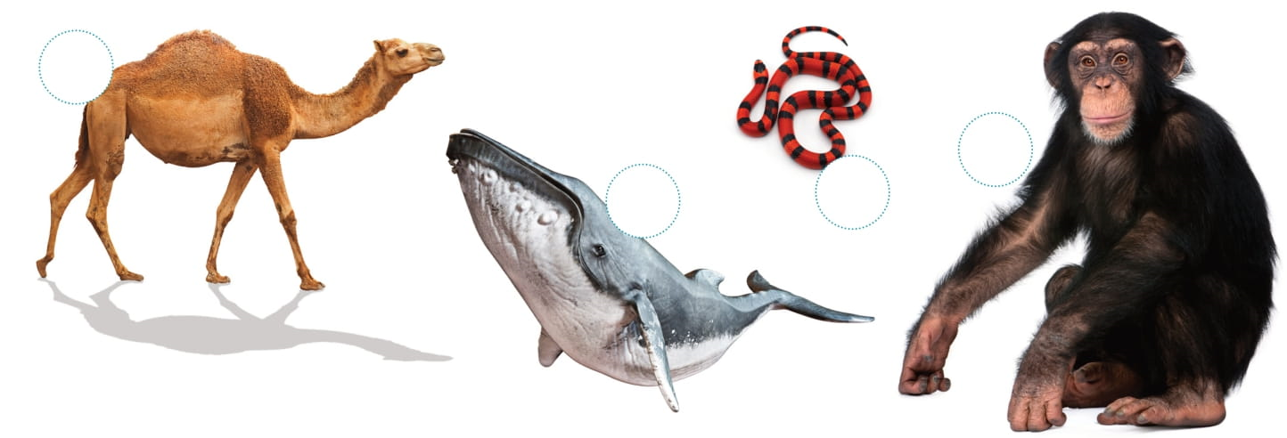
8
6
1
3
2
7
5
4

Slide 19
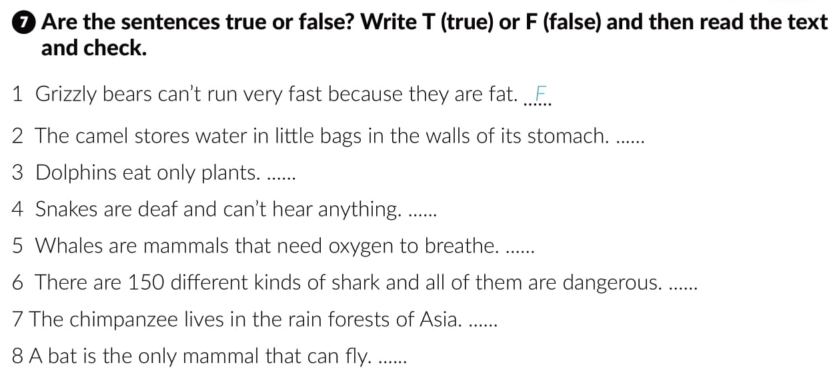
F
F
T
T
F
F
T

Slide 20
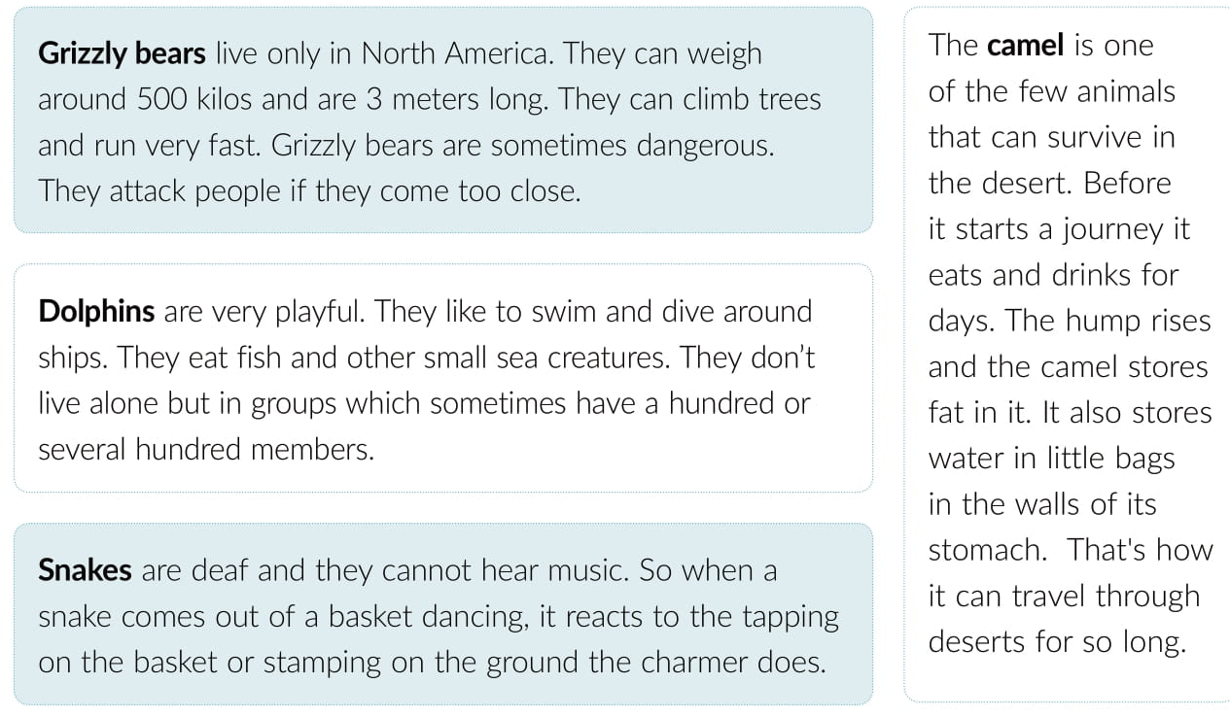
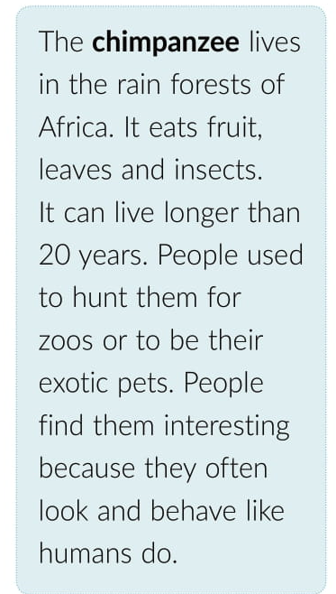
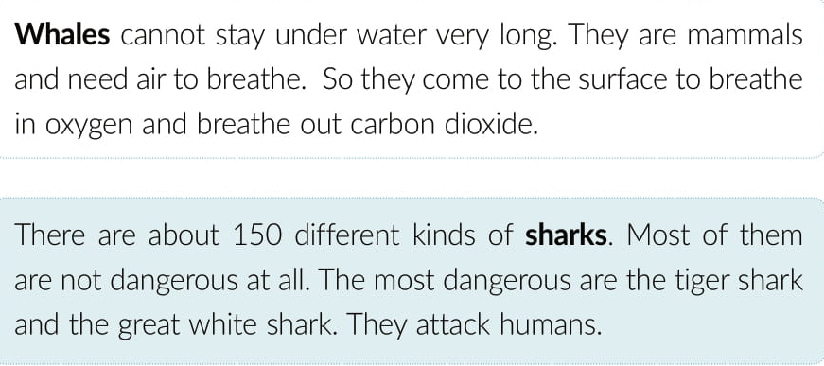
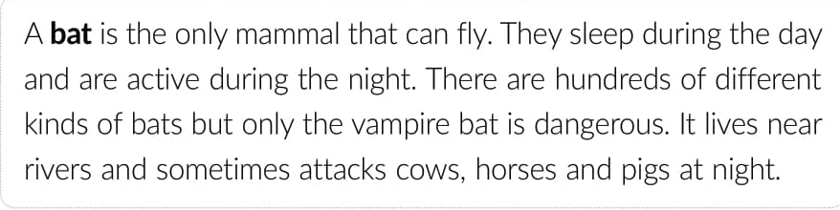

Slide 21
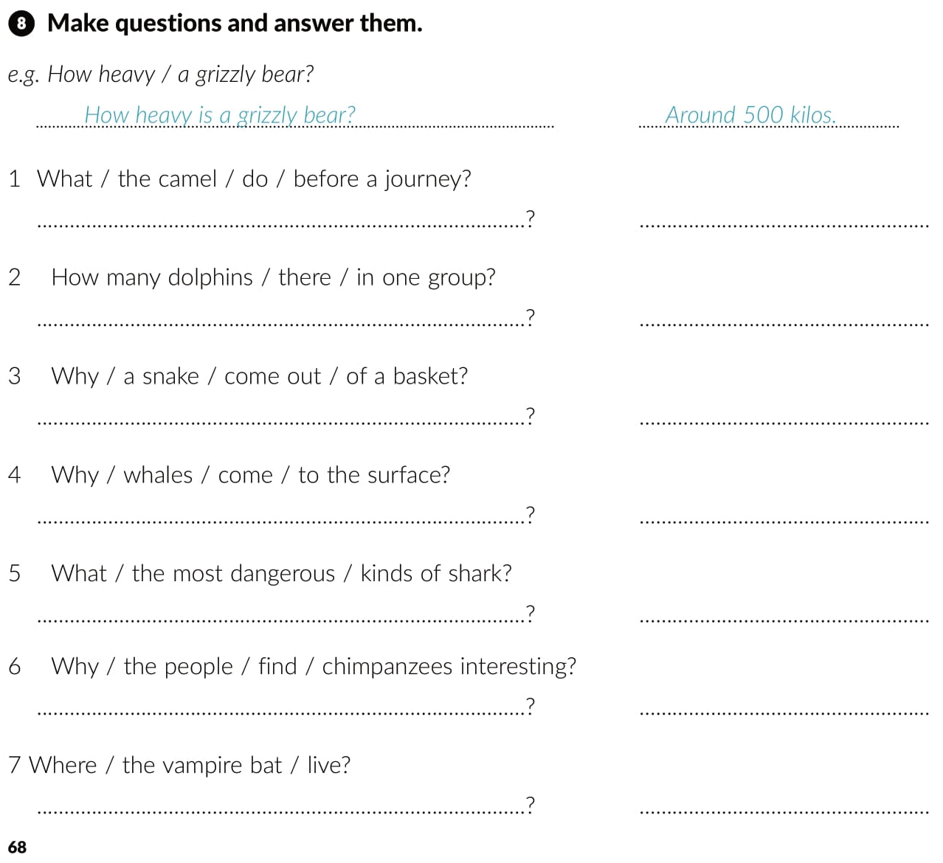
What does the camel do before a journey
It eats and drinks for days.
How many dolphins are there in one group
There are a hundred or several hundred.
Why does a snake come out of a basket
It reacts to the tapping on the basket.
Why do whales come to the surface
To breath in oxygen and breath our carbon dioxide.
Who are the most dangerous kinds of shark
The tiger shark and the great white shark.
Why do people find chimpanzees interesting
Because they often look and behave like humans do.
Where does the vampire bat live
It lives near rivers.

Slide 22
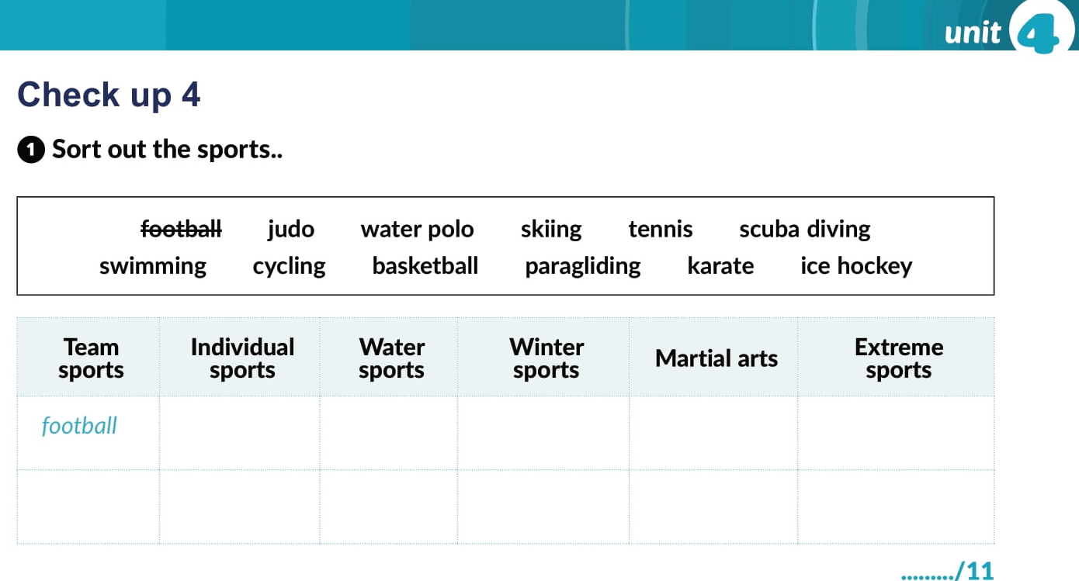
tennis
water polo
skiing
judo
scuba diving
basketball
cycling
swimming
ice hockey
karate
paragliding
ice hockey

Slide 23
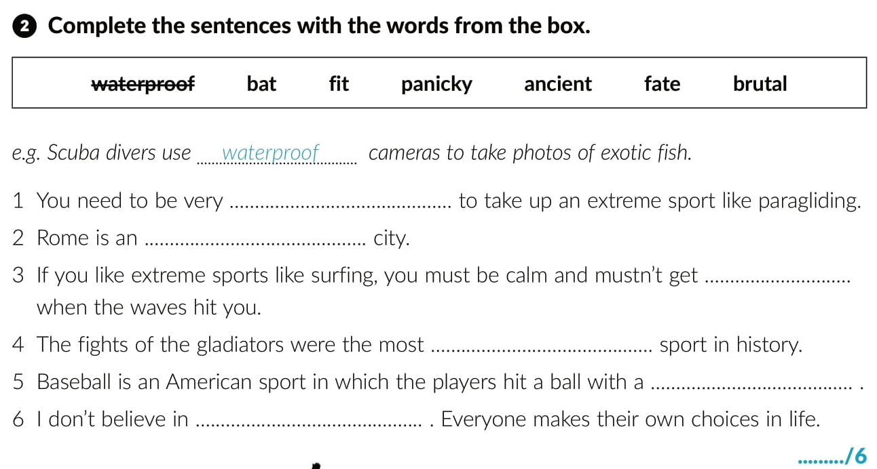
fit
ancient
panicky
brutal
bat
fate

Slide 24
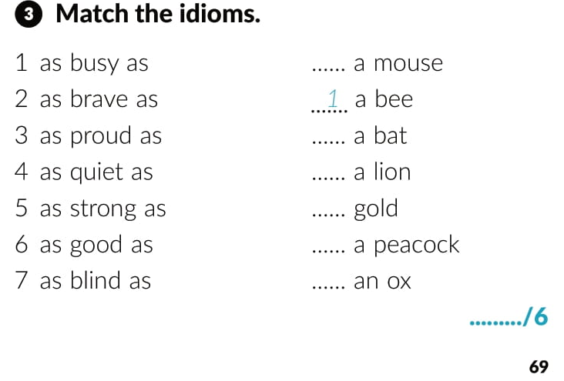
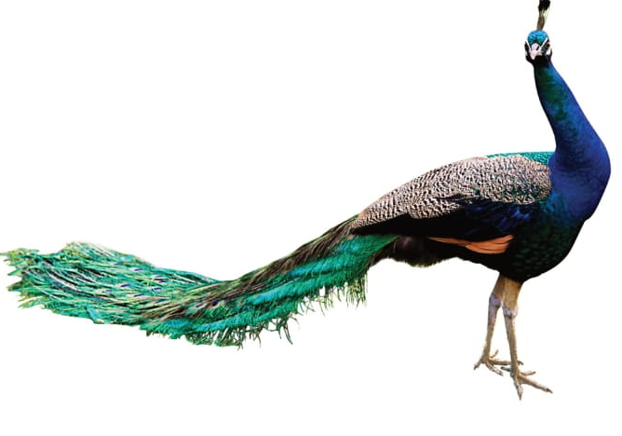
4
7
2
6
3
5

Slide 25
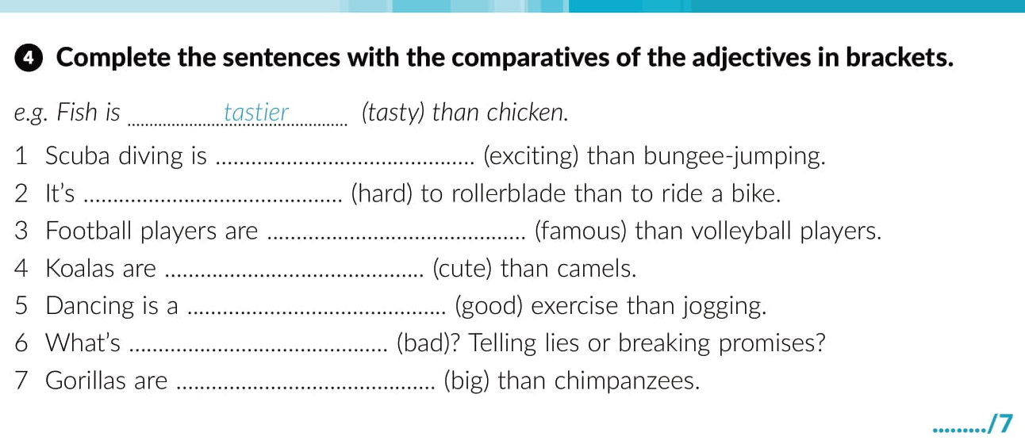
more exciting
harder
more famous
cuter
better
worse
bigger

Slide 26
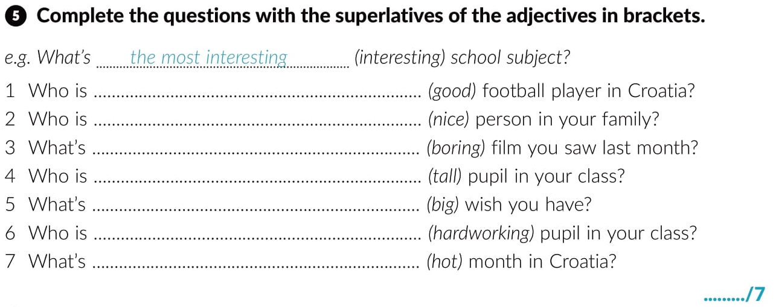
the best
the nicest
the most boring
the tallest
the biggest
the most hardworking
the hottest

Slide 27
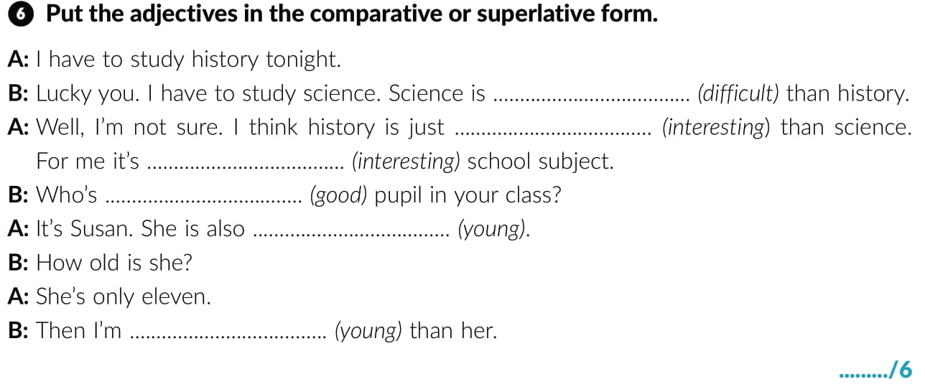
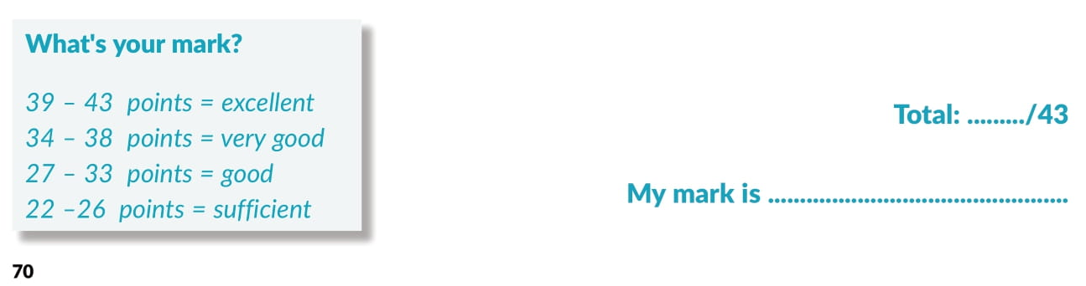
more difficult
more interesting
the most intetresting
the best
the youngest
younger

Slide 28
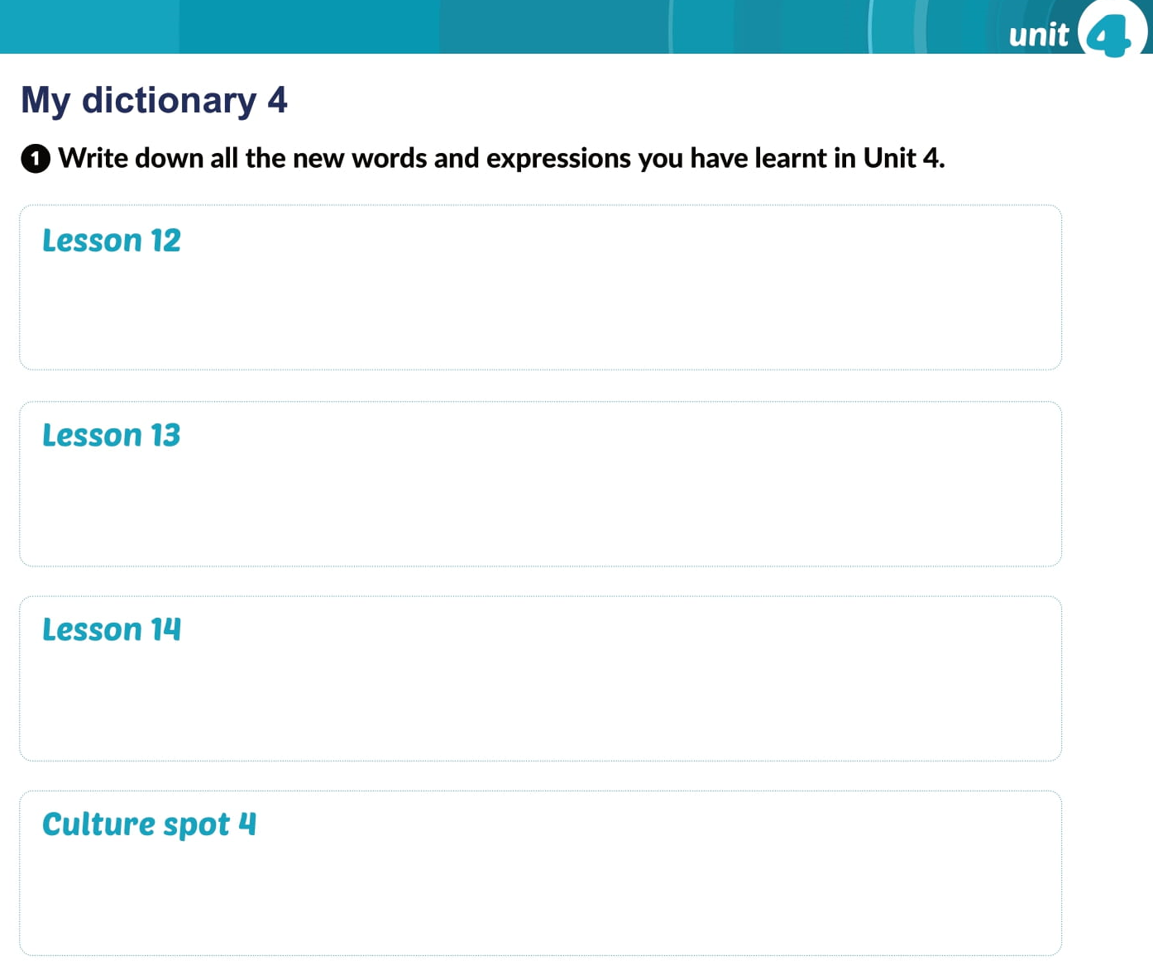

Slide 29
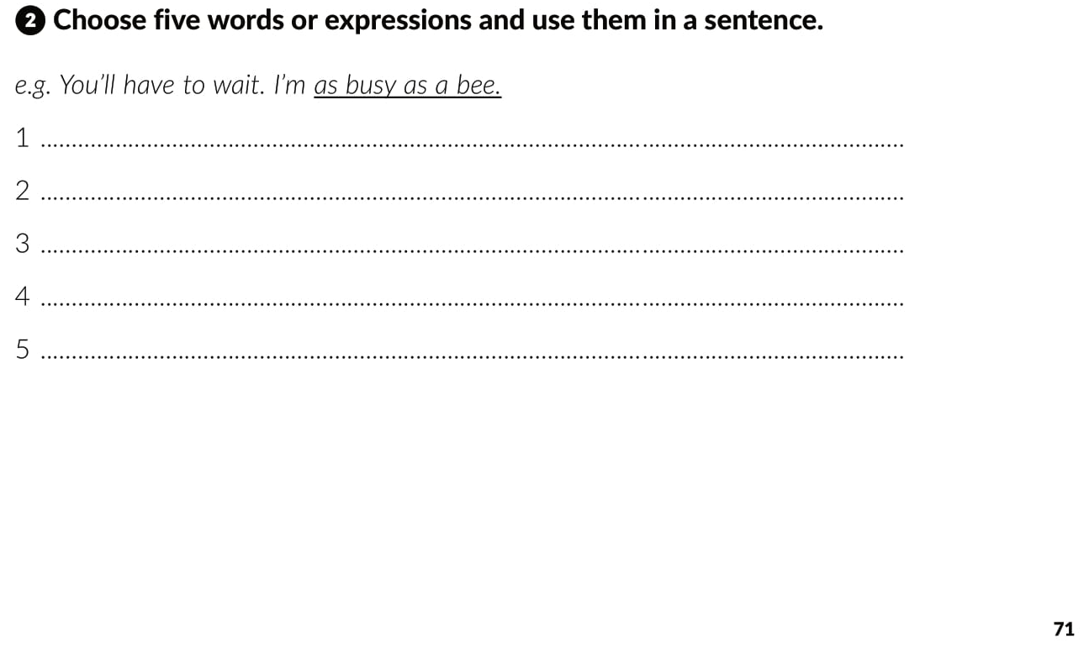

Slide 30
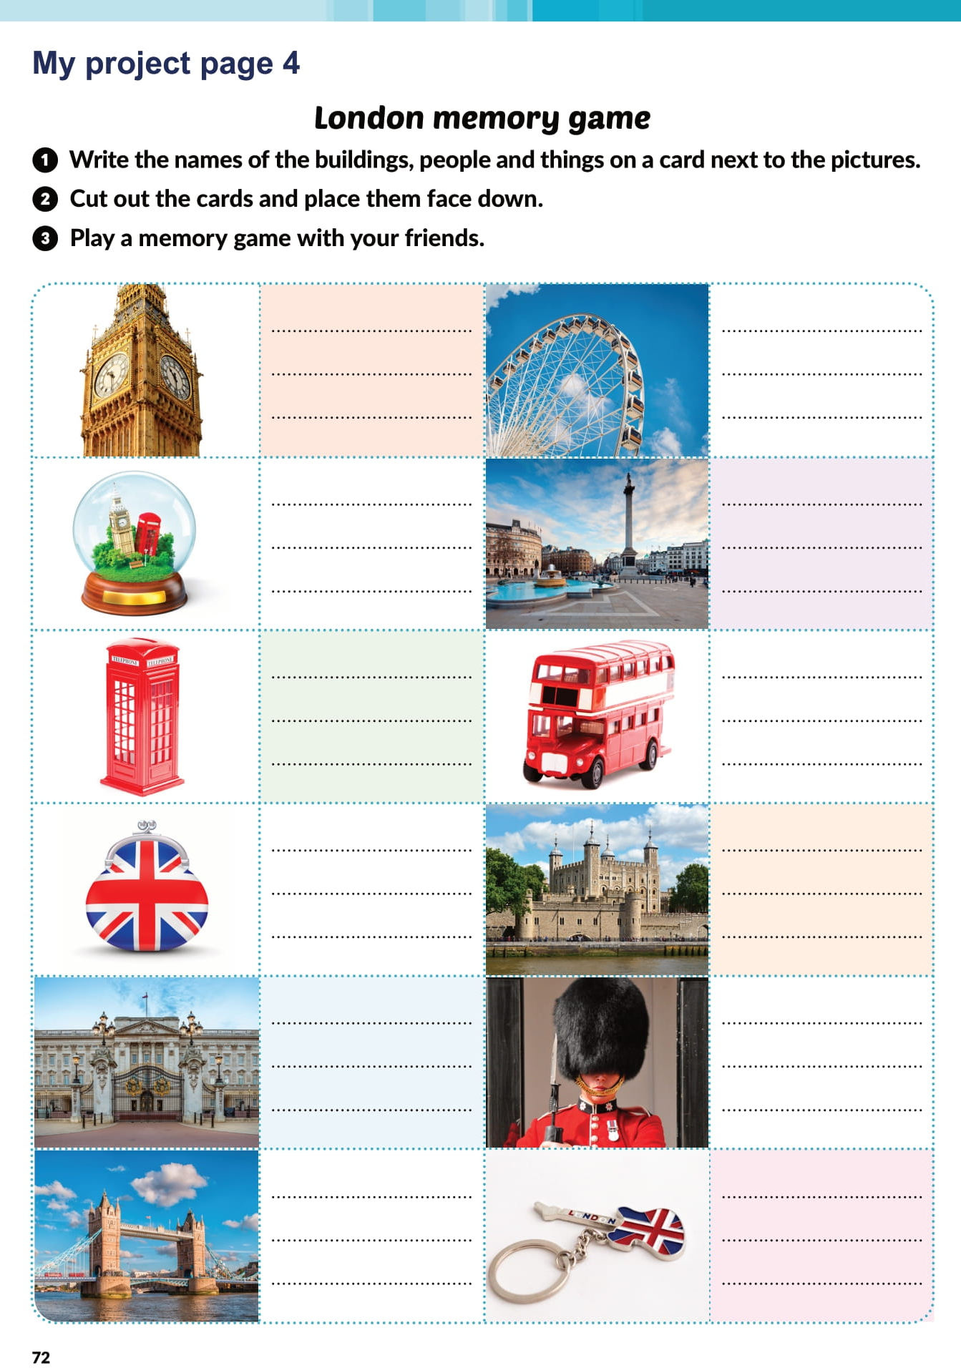
Big Ben
London Eye
a snow globe
Trafalgar Square
a phone booth
a double-decker bus
a coin purse
Tower of London
Buckingham pallace
the Queen’s Guard
Tower Bridge
a key chain

Slide 31

PLAY AND LEARN!
https://www.e-sfera.hr/dodatni-digitalni-sadrzaji/0fd2934a-c1ef-436d-aa7d-d687678a752a/

